Slide 1
RETAIL PRICE
GROUP 19

Slide 2
Group Members
Abhishek, 2001ME02
Abhishek Verma, 2001ME04
Ansh Saxena, 2001ME10
Sakshi Yadav, 2001ME65
Veer Bahadur Singh, 2001ME80
Vipin Kumar Dhakad, 2001ME81

Slide 3
Index
Data Collection
Data Pre-processing and Cleaning
Data Visualization
Data Statistics
Hypothesis Testing
Machine Learning Model

Slide 4
Data Collection
Data collection is a systematic process of gathering observations or measurements.
Source: https://www.kaggle.com/kk9969/retail-prices-of-commodities-in-india
The Dataset contains the retail prices of commodities, weekly and monthly and further divided into food and non-food categories across different states of India.

Slide 5
Data Pre-processing and Cleaning
Manipulating or dropping data before it is used in order to ensure or enhance performance.
We have done the following things:
Dropping unnecessary rows in a Data Frame
Changing the index of a Data Frame Using .str() methods to clean rows
Using the DataFrame.applymap() function to clean the entire dataset, element-wise
Renaming columns to a more recognizable set of labels
Skipping unnecessary rows in a CSV file

Slide 6
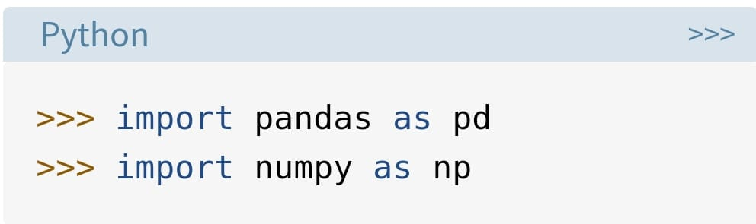
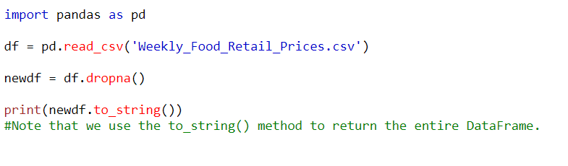
Importing libraries as shown below:

Slide 7

The dropna() method removes the rows that contains NULL values.
The dropna() method returns a new Data Frame object unless the inplace parameter is set to True, in that case the dropna() method does the removing in the original Data Frame instead.

Slide 8
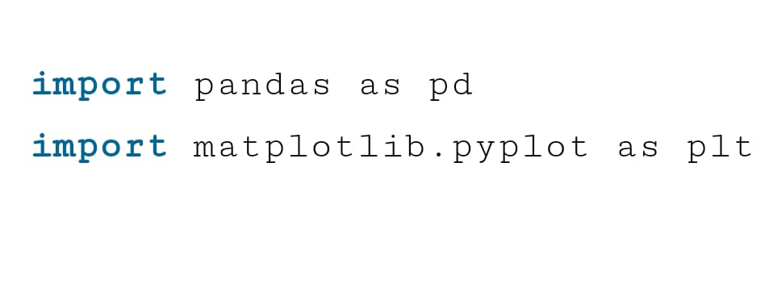
Data Visualisation
Data visualization is the graphic representation of information and data.
We used Matplotlib library for plotting the graph.

Slide 9

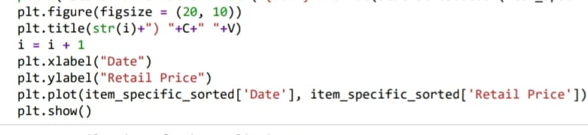
Conversion of Date format from string to object type for sorting purpose.
Library Used:
  from datetime import datetime

Slide 10
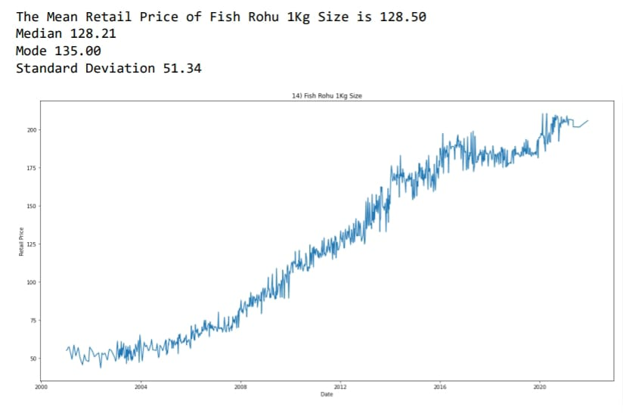
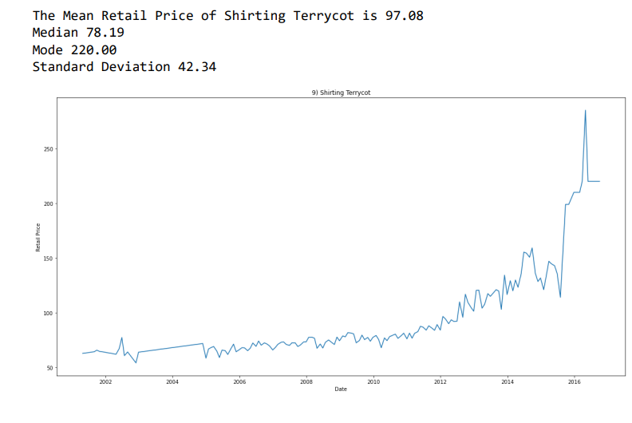

Slide 11
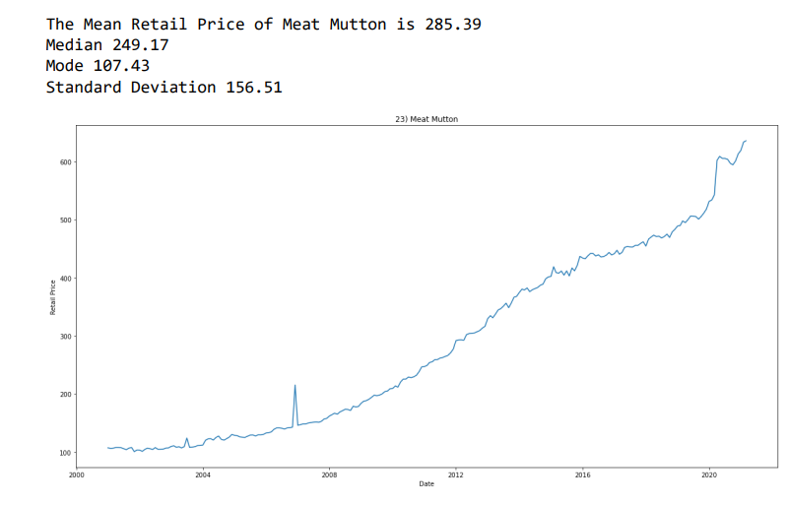

Slide 12
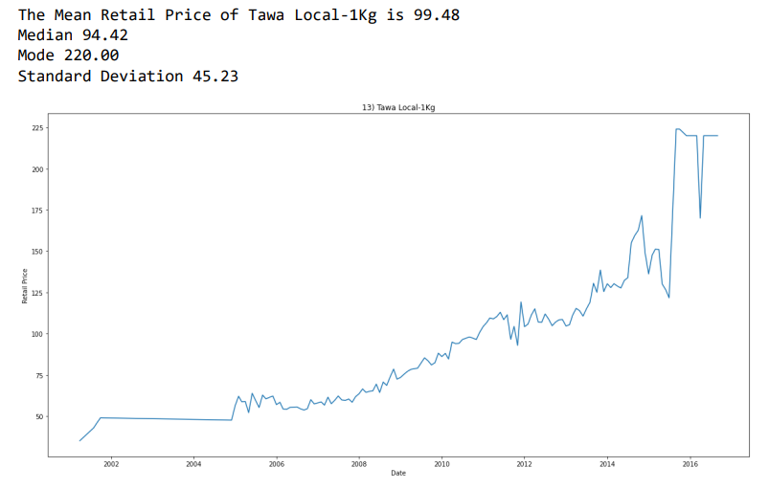

Slide 13
Data Statistics
statistics.mean(data)
  Return the sample arithmetic mean of data which can be a sequence or iterable.
  It is a measure of the central location of the data.
Libraries Used:
  import statistics

Slide 14
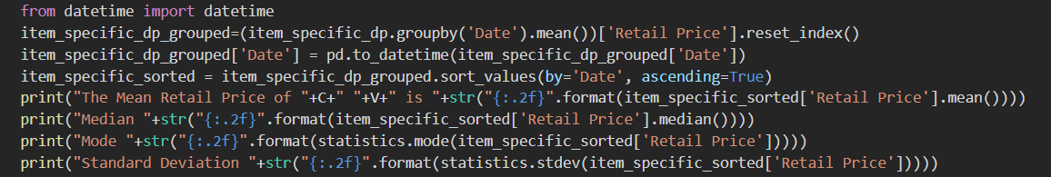
Mean:
  data_frame[‘Retail Price’].mean()
Median:
  data_frame[‘Retail Price’].median()
Mode:
  statistics.mode(data_frame[‘Retail Price’])

Slide 15
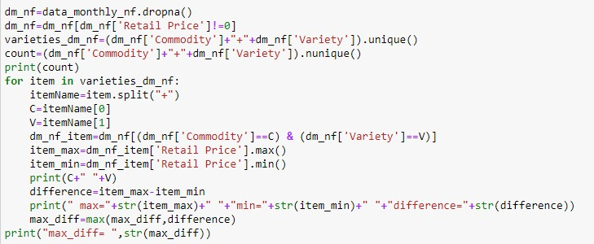
Answering some interesting Questions
Which commodity had the highest increase in the retail price?
For food:
Cumin Seeds (common)
For non-food
  Chappal (Rubber Bata)

Slide 17
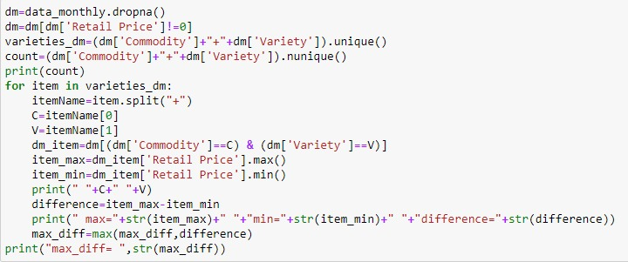
Which commodity’s price changed the least since 2001?
For food:
Salt packet (iodised)
For non-food:
  Bathing soap (hamam)

Slide 18
Hypothesis Testing
Hypothesis testing is a statistical method that is used in making statistical decisions using experimental data.
Hypothesis Testing is basically an assumption that we make about the population parameter.
A hypothesis test evaluates two mutually exclusive statements about a population to determine which statement is best supported by the sample data.

Slide 19
Null hypothesis :-
  In inferential statistics, the null hypothesis is a general statement or default position that there is no relationship between two measured phenomena, or no association among groups.
Alternative hypothesis :-
  The alternative hypothesis is the hypothesis used in hypothesis testing that is contrary to the null hypothesis. It is usually taken to be that the observations are the result of a real effect.
Libraries Used:
  scipy.stats as stats
  math
  statsmodels.api as sm

Slide 20
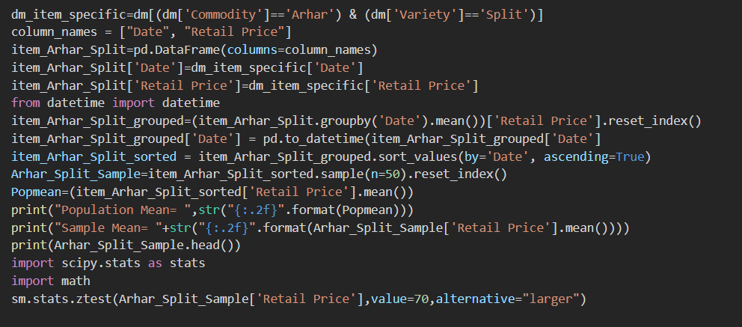
Hypothesis Testing for ‘Arhar-Split’ from Monthly dataset
Null Hypothesis:
  The average Retail Price of Commodity "Arhar Split" is 70.
Alternate Hypothesis:
  The average Retail Price of Arhar Split is greater than 70.

Slide 21
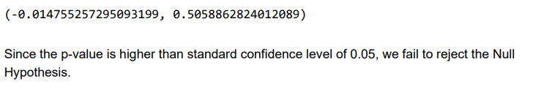
Hypothesis Testing for ‘Ragi-FAQ’ from Monthly dataset
Null Hypothesis:
  The average Retail Price of Commodity "Ragi FAQ" is 20.
Alternate Hypothesis:
  The average Retail Price of Ragi FAQ is greater than 20.

Slide 22
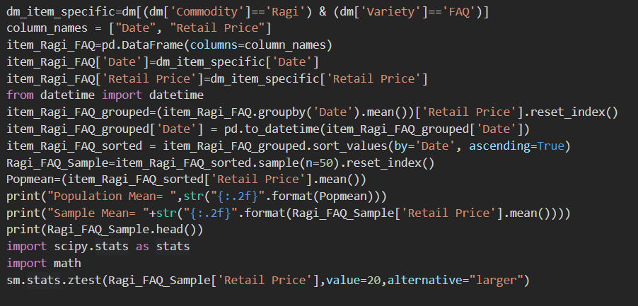
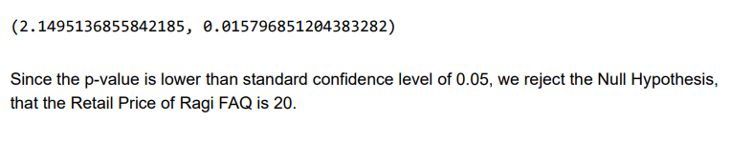

Slide 23
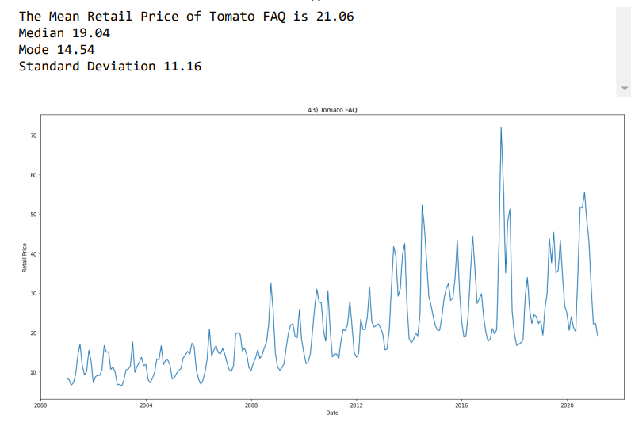
INSIGHTS:
From the graph we can observe that there is a lot of fluctuations in retail price.
This is because Tomato is a seasonal fruit that’s why its price gets increased whenever it gets out of season.

Slide 24
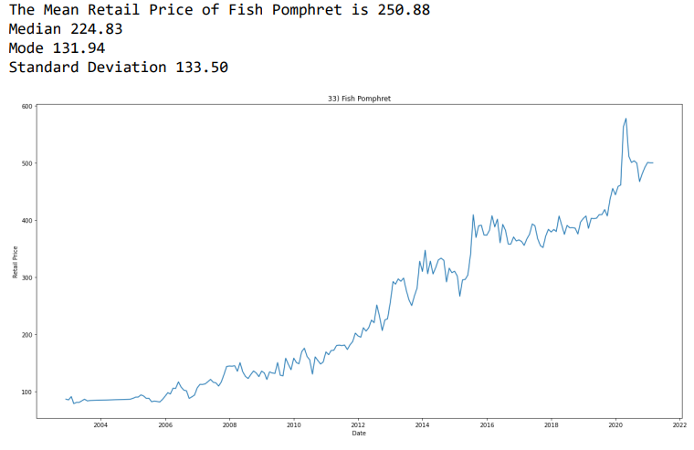
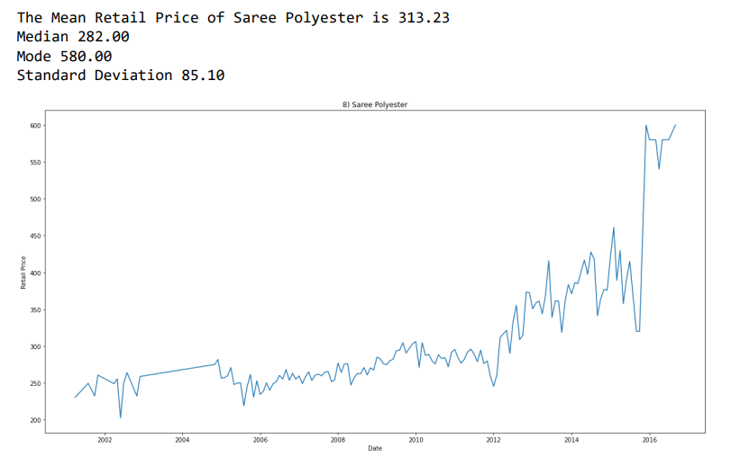
As we can see from graph after 2020 there is a sudden increase in the retail price, this is due to covid-19

Slide 25
Model Evaluation
Model evaluation is the process of using different evaluation metrics to understand a machine learning model's performance, as well as its strengths and weaknesses.
Importance - Model evaluation is important to assess the efficiency of a model during initial research phases, and it also plays a role in model monitoring.

Slide 26
The three main metrics used to evaluate a classification model are accuracy, precision, and recall.
Accuracy is defined as the percentage of correct predictions for the test data. It can be calculated easily by dividing the number of correct predictions by the number of total predictions.
accuracy=correct predictions/all predictions
Precision is defined as the fraction of relevant examples (true positives) among all of the examples which were predicted to belong in a certain class.
precision=true positives /(true positives + false positives)
Recall is defined as the fraction of examples which were predicted to belong to a class with respect to all of the examples that truly belong in the class.
recall=true positives/( true positives + false negatives)

Slide 27
Support Vector Machine (SVM)
This method is used by us to do modal evaluation.
“Support Vector Machine” (SVM) is a supervised machine learning algorithm that can be used for both classification or regression challenges. However, it is mostly used in classification problems.
Support Vectors are simply the coordinates of individual observation. The SVM classifier is a frontier that best segregates the two classes (hyper-plane/ line).

Slide 28
How does SVM Algorithm works?
SVM works by mapping data to a high-dimensional feature space so that data points can be categorized, even when the data are not otherwise linearly separable. A separator between the categories is found, then the data are transformed in such a way that the separator could be drawn as a hyperplane.
The mathematical function used for the transformation is known as the kernel function. SVM in supports the following kernel types:
  Linear
  Polynomial
  Radial basis function (RBF)
  Sigmoid

Slide 29
ILLUSTRATION: PREDICTION OF PRICE OF RED CHILLIES POWDER AGMARK
First we use data of Red chillies powder agmark for training purpose and testing purpose with a ratio of 91% to 9%.
Data splitting is done using the function train_test_split from sklearn.model_selection.

Slide 30
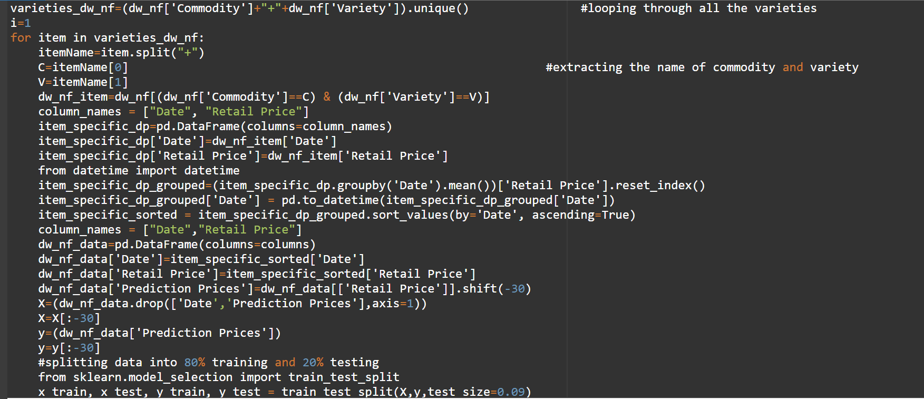
CODE-

Slide 31
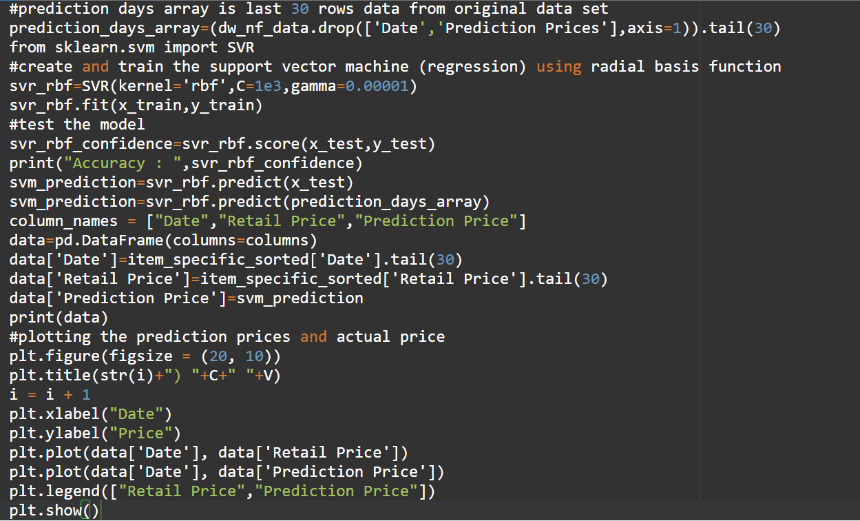

Slide 32
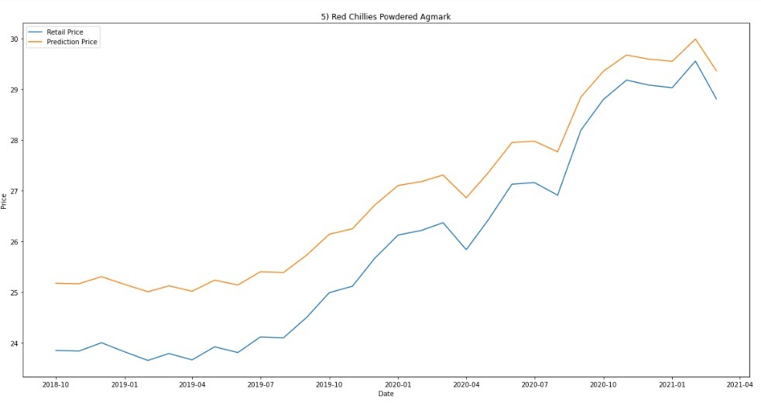
Graphs ( Price vs Date) of predicted value and actual value for some of the commodities shown below:

Slide 33
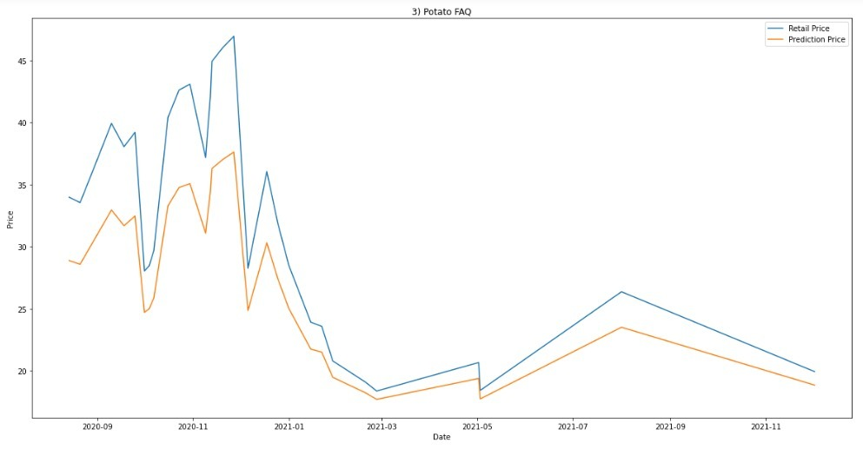

Slide 34
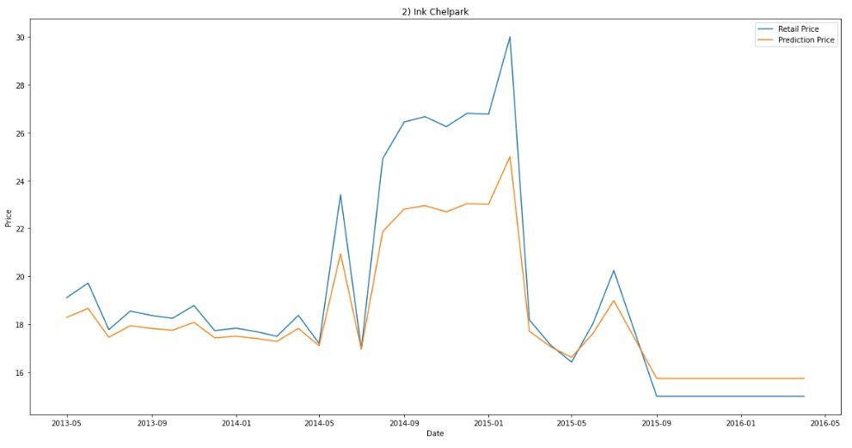

Slide 35
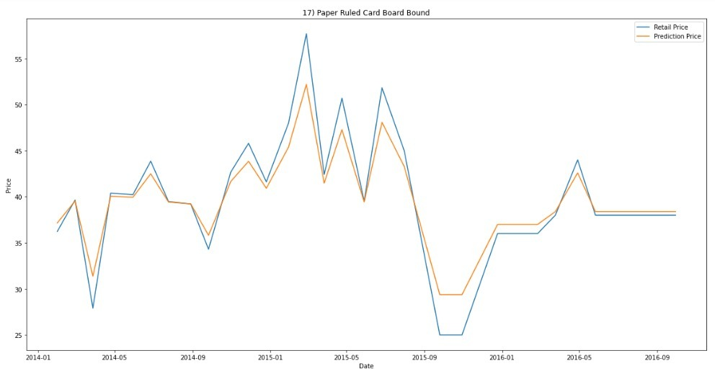

Slide 36
CONCLUSION
We have predicted the price of 68 commodities using svm model with accuracy in the range of 50%-96%.
For some commodities, the model fails to predict the price as there are plenty of unexpected fluctuations in the actual price of the commodity.
There are other models also for prediction of price through which price can be predicted such as LinearRegression, kNeighbors, etc. each with different accuracy of predictions.

Slide 37
Thank You

